Slide 1
Yelp Review
Sentiment Analysis
Zihao Xu
Yuxuan Hong
James Ren

Slide 2
Agenda
Problem & Motivation
Data Description
Exploratory Analysis
Sentiment Analysis
Future Directions

Slide 3
Problem & Motivation
Explore interesting data trends/patterns
Analyze sentiment changes over time
Build a rating predictor based on review sentiment

Slide 4
Dataset Description
From Yelp Data Challenge
Review.csv
Business.csv
User.csv
Notes:
Json -> csv
Merge
Pandas dataframe

Slide 5
Dataset Description
Facts:
unique reviews: 4737000
unique users: 970000
unique businesses: 102500
time span: 2004 - 2017
size of review.csv: 3.9 GB

Slide 6
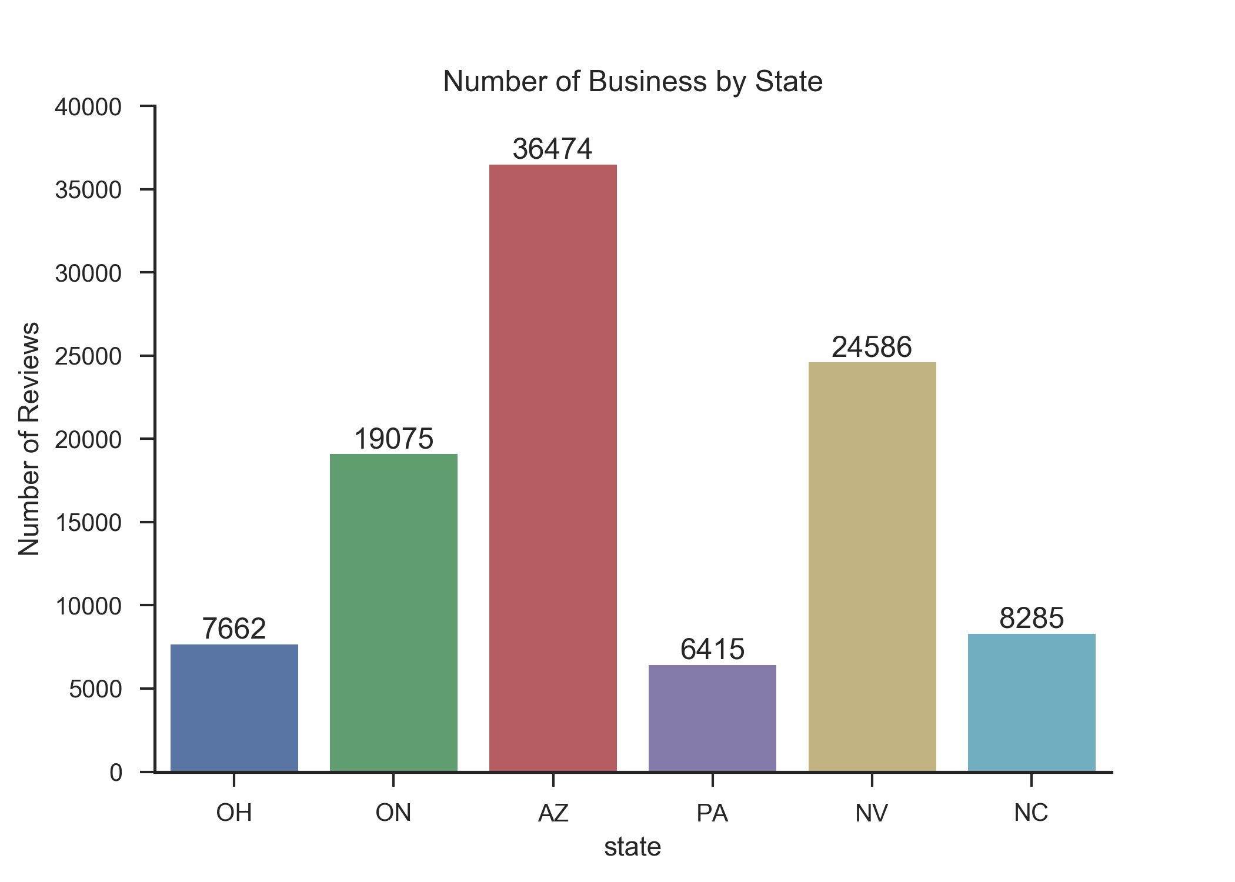
Dataset Description
Notes:
Filter:
Business review>10
User review > 5
Over 20 states represented; picked data from top 6 states

Slide 7
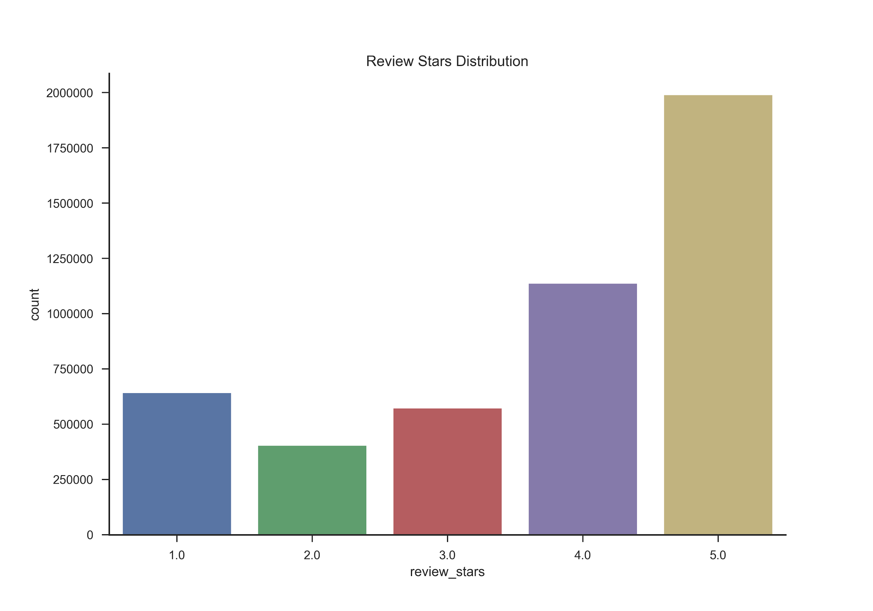
Dataset Description

Slide 8
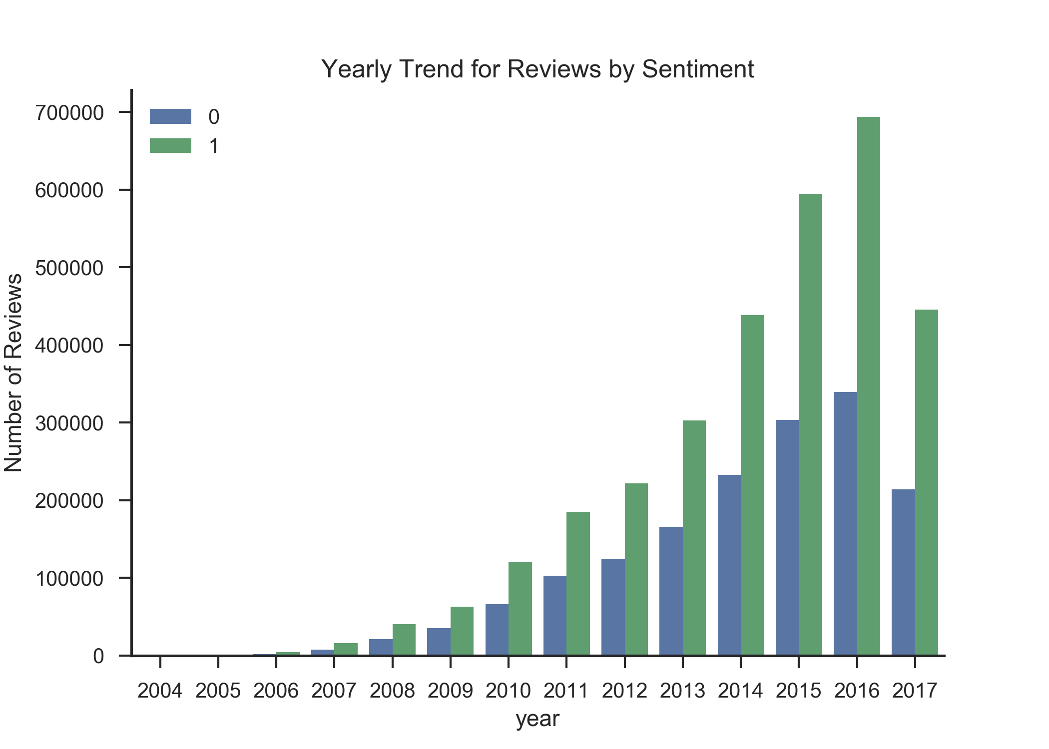
Dataset Description
Notes:
1= positive
0= negative
Overall number of review increase; more positive than negative

Slide 9
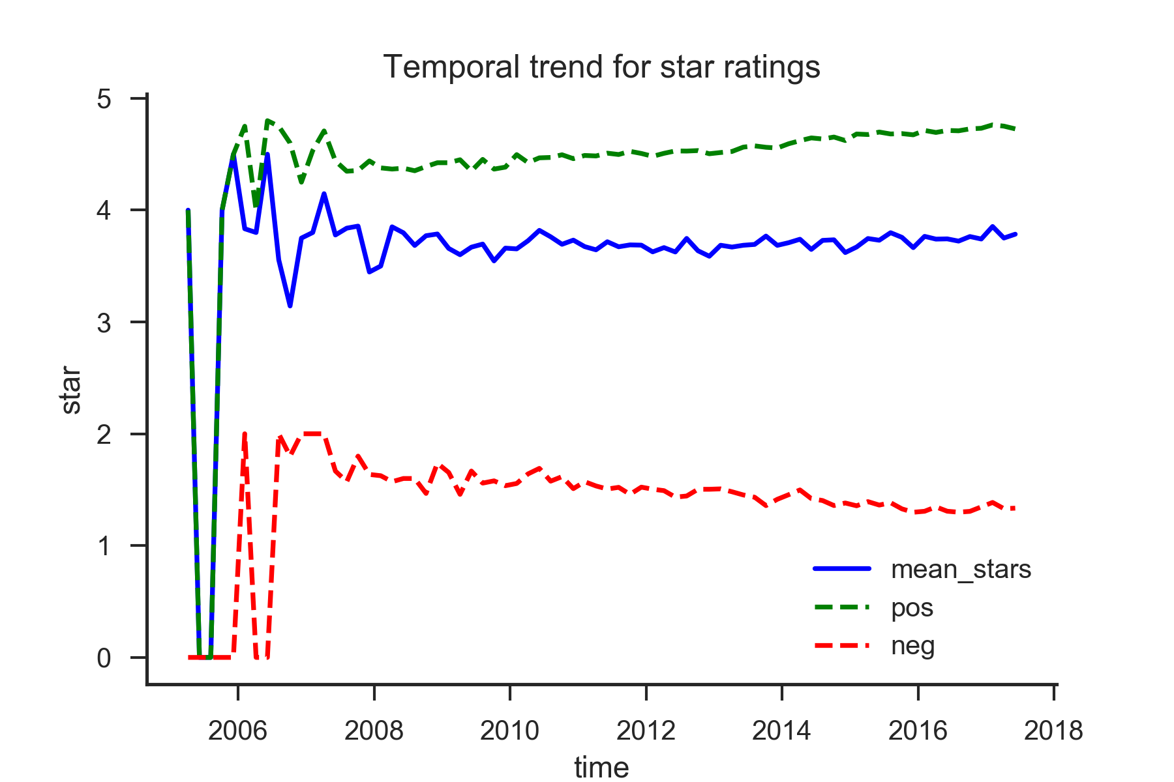
Exploratory Analysis
Notes:
Positve : 4 or 5
Negative: 1 or 2
Slight trend upwards/downwards

Slide 10
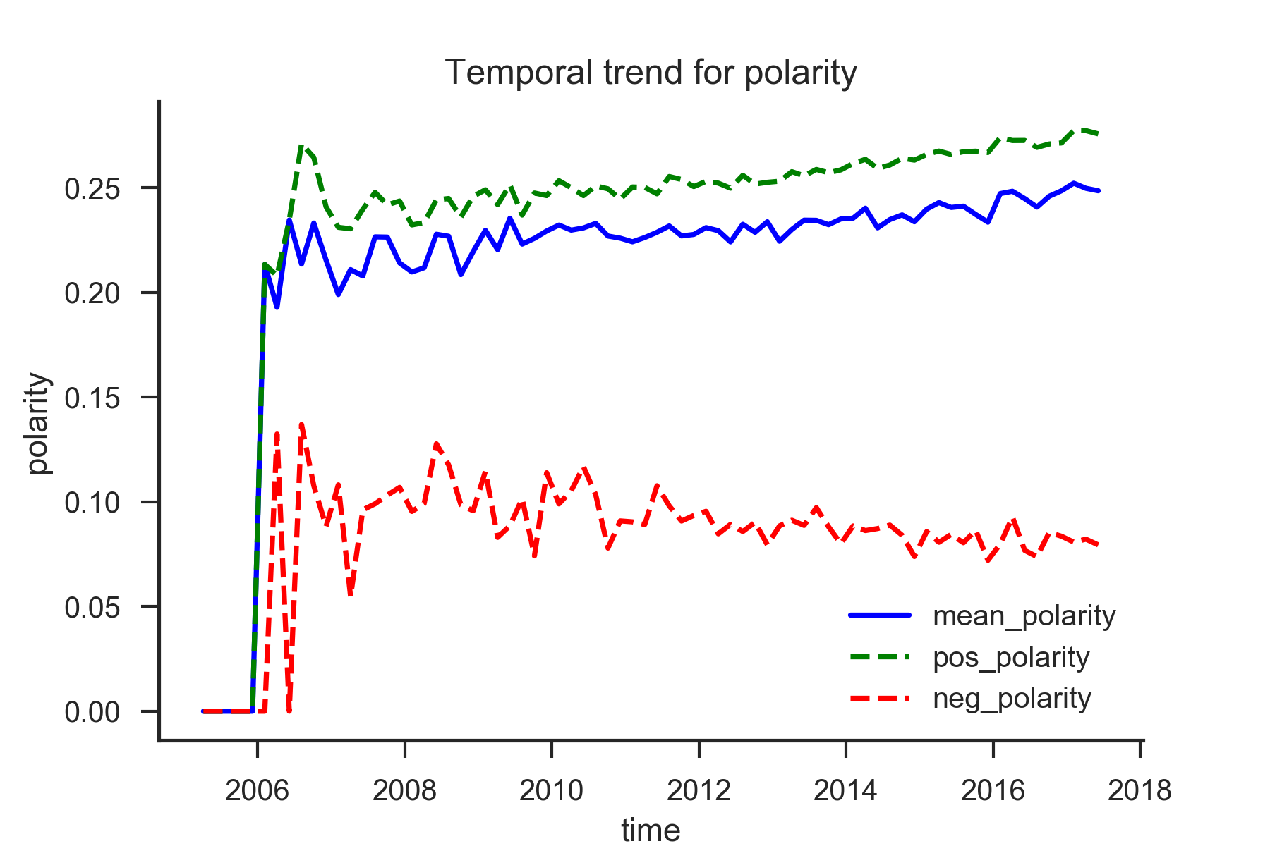
Exploratory Analysis
Notes:
Correspond
below/above median
Polarity: (p-n)/(p+n) [-1,1]

Slide 11
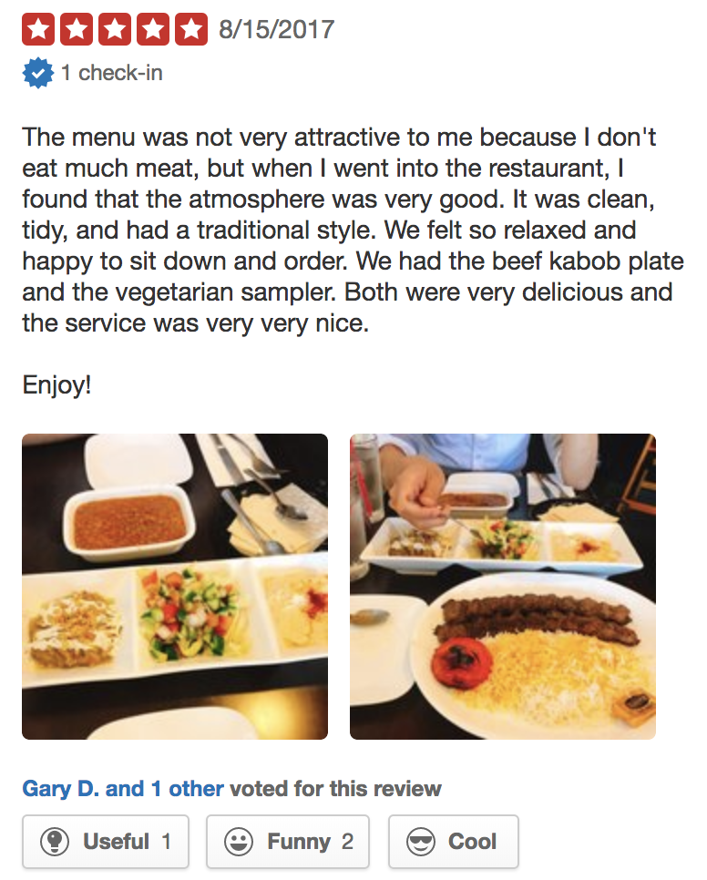
Exploratory Analysis
Review Tags:
Useful
Funny
Cool

Slide 12
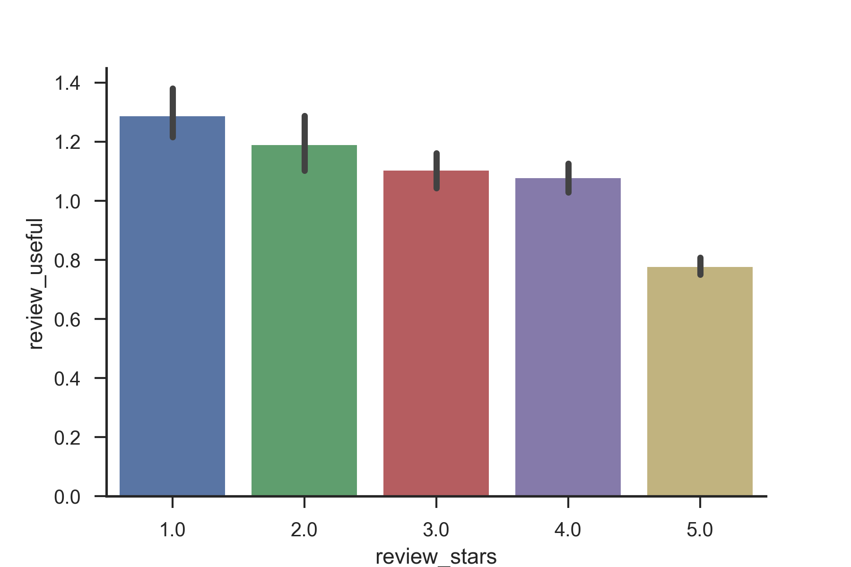
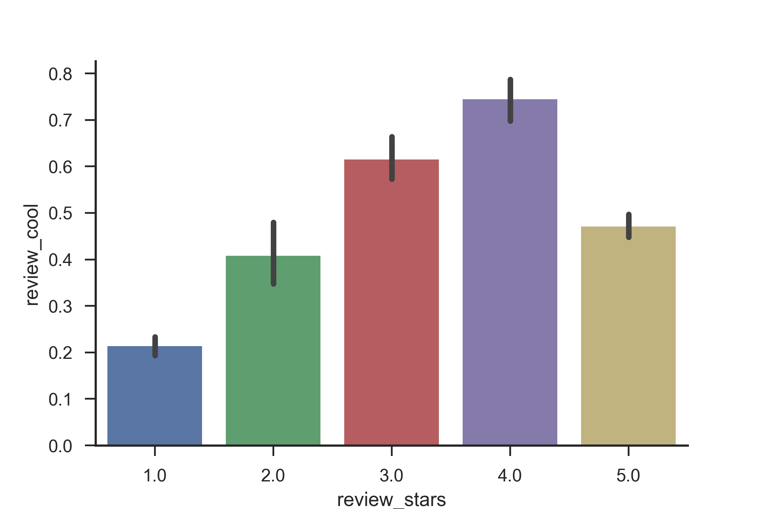
Exploratory Analysis
Notes:
Avg number of tags per review

Slide 13
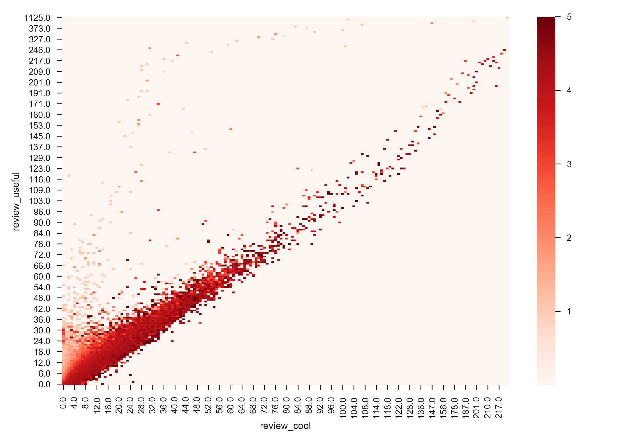
Exploratory Analysis
Notes:
Review with similar percentile of coolness/usefulness: higher rating
useful/not so cool: lower rating

Slide 14
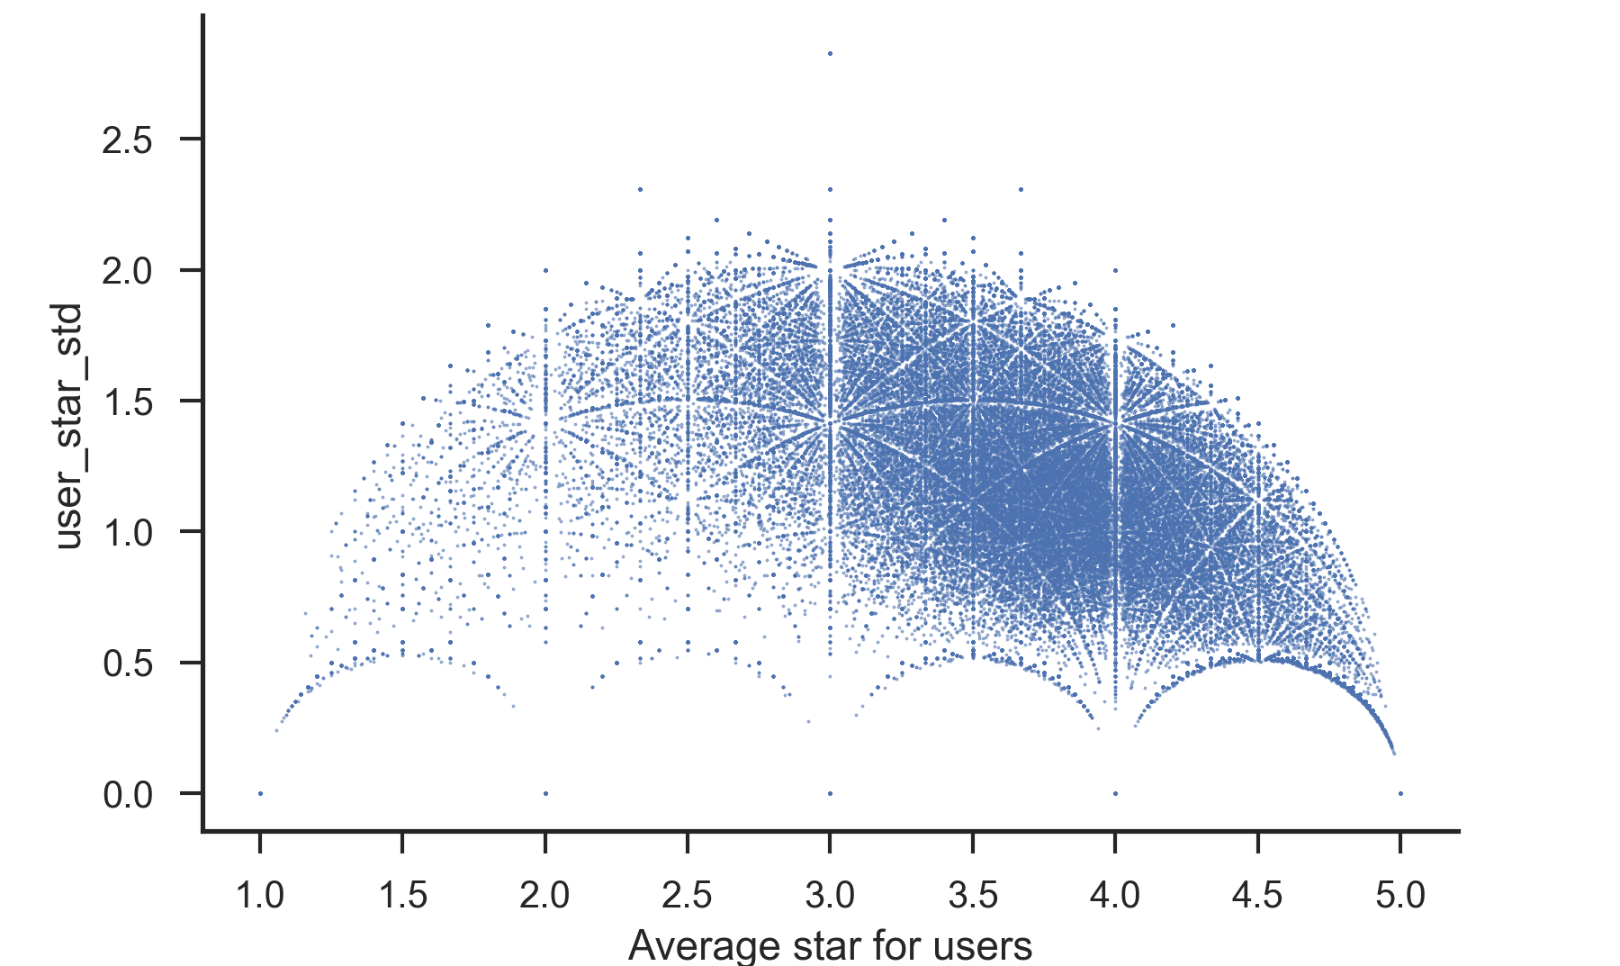
Mean vs. Standard Deviation
Notes:
Per user

Slide 15
Sentiment Analysis
Methods:
Select [‘review_text’, ‘review_stars’]
Encode review_star: “pos”, “neg”
Stem review_text and remove stop words
Generate a sparse matrix representation of text
ML models training and evaluation
Ensemble methods: voting classifier

Slide 16
Sentiment Analysis
Text processing
Example = "The python programmer named pythoner is pythoning a game pythonly"
Word_tokenize
['The', 'python', 'programmer', 'named', 'pythoner', 'is', 'pythoning', 'a', 'game', 'pythonly']
Clean_format
['the', 'python', 'programmer', 'named', 'pythoner', 'is', 'pythoning', 'a', 'game', 'pythonly']
Remove_stop_words
['the', 'python', 'programmer', 'named', 'pythoner', 'pythoning', 'game', 'pythonly']
PorterStemmer
['the', 'python', 'programm', 'name', 'python', 'python', 'game', 'pythonli']

Slide 17
Sentiment Analysis
.
,
Raw Counts vs. Tfidf Weights:
['the', 'python', 'programm', 'name', 'python', 'python', 'game', 'pythonli']
Raw Counts:
[1, 1, 2, 1, 1, 3]
Tfidf Weights:
[ 0.102, 0.994, 0.045, 0.872, 0.453, 0.175, 0.032, 0.927, 0.321, 0.124, 0.142]

Slide 18
Sentiment Analysis
Features considered:
Individual words: “best” “never”
2-grams: “best place” “never ever”
Capitalized words: “BEST” “NEVER”

Slide 19
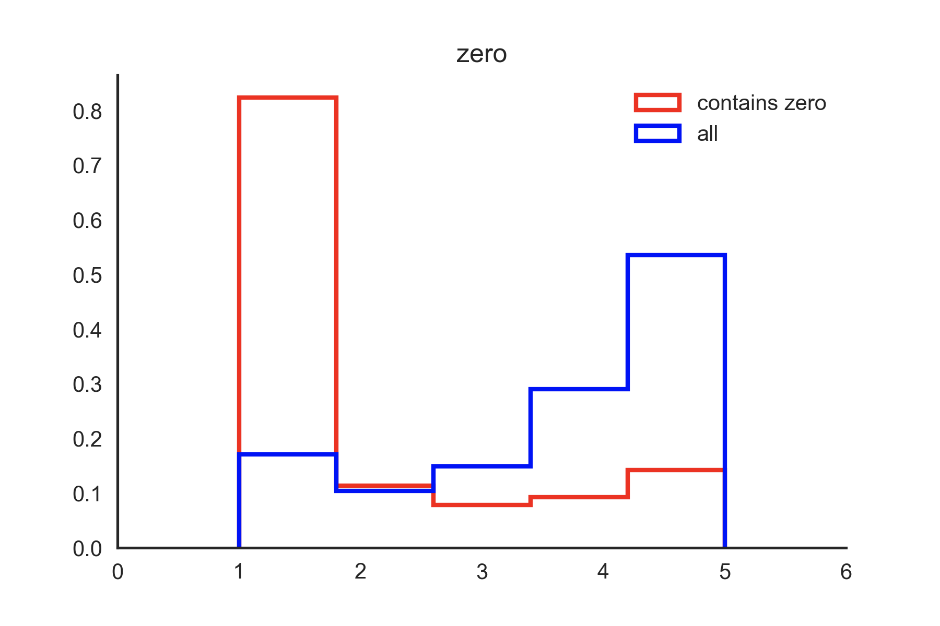
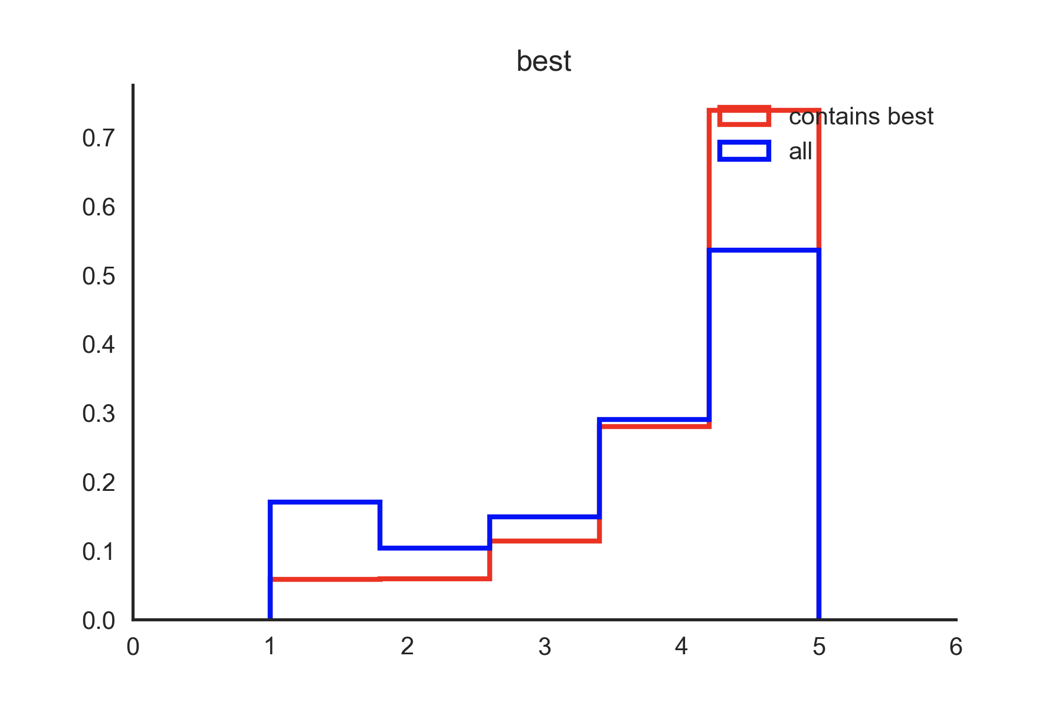
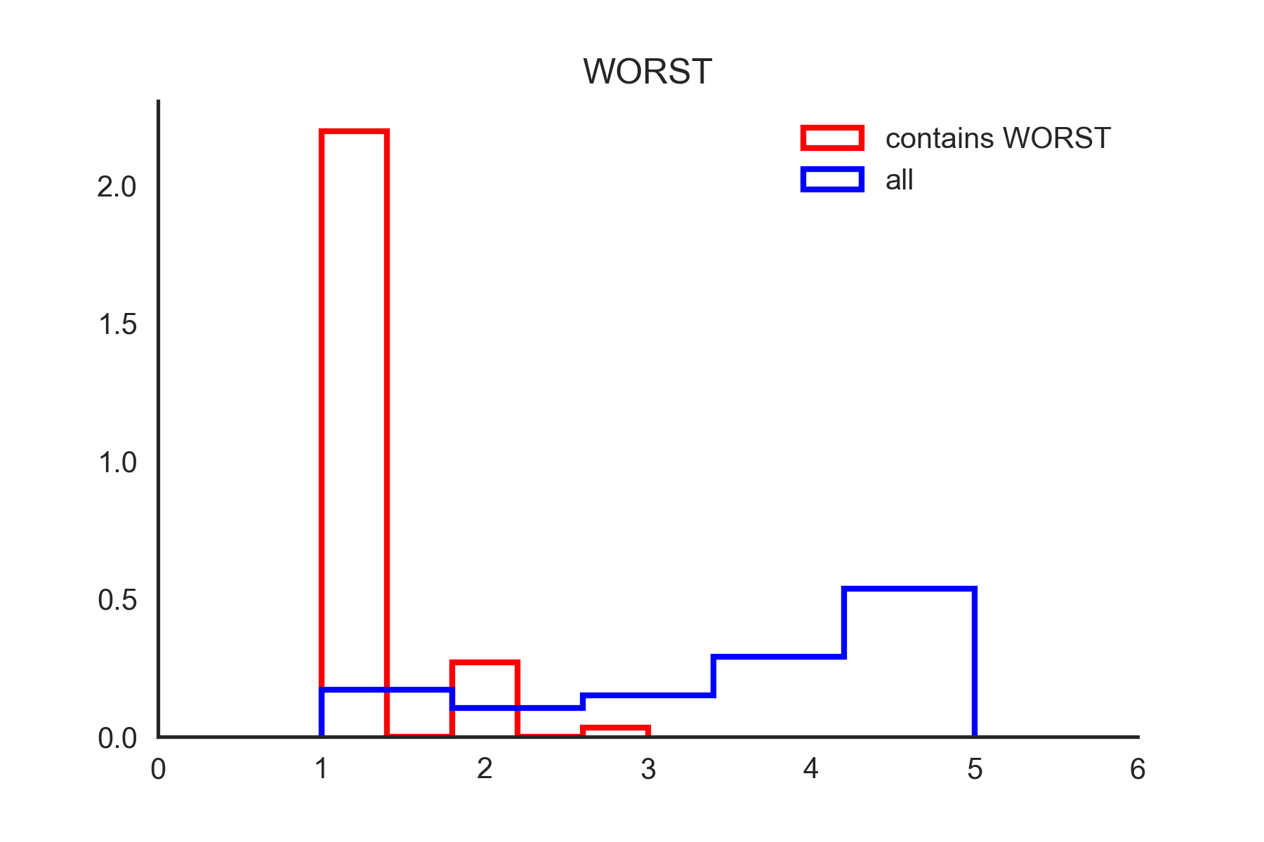
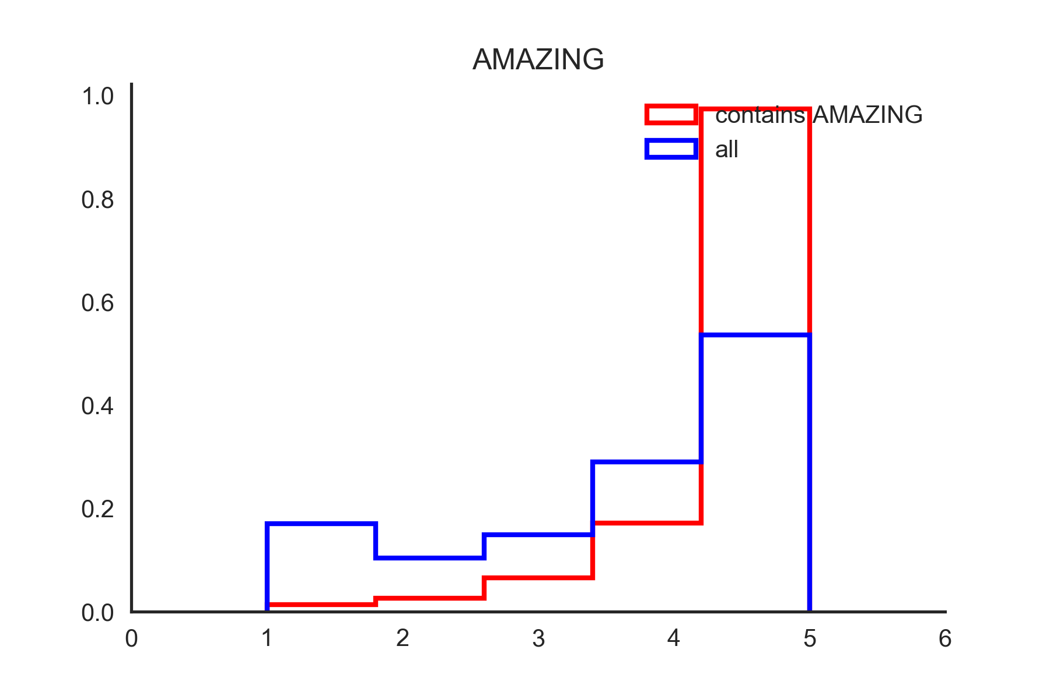

Slide 20
Model Training
Benchmark: 75% of all reviews are positive
Train / Test size: 140,917 / 46,972
Steps:
Naive Bayes using Counts with only individual words
More advanced clfs using Tfidf with only individual words
More advanced clfs using Tfidf with words + 2-grams + CAPITAL
Voting clf that combines top 3 clfs

Slide 21
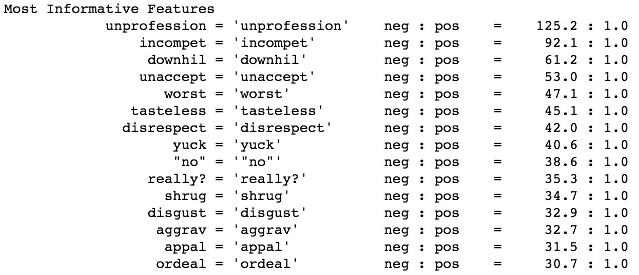
First attempt: Naive Bayes
45% test accuracy… BUT!

Slide 22
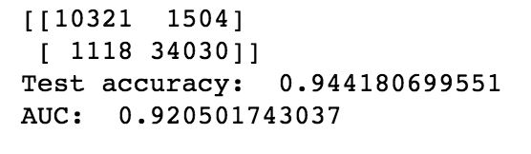
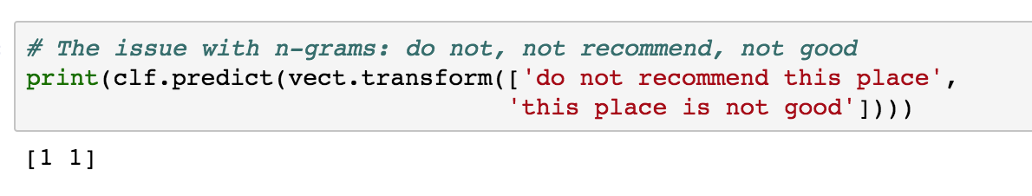
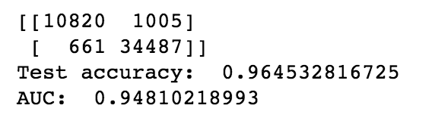
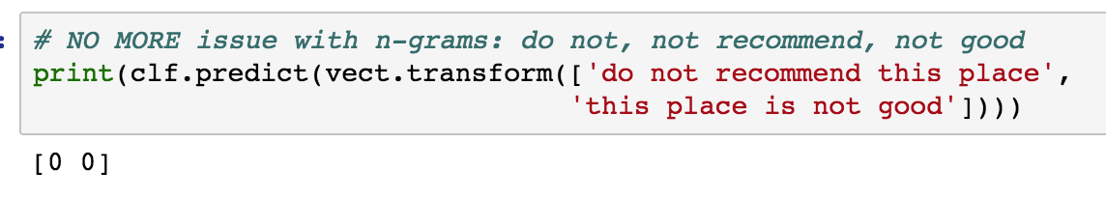
Importance of n-grams
Before using
2-grams
After using
2-grams

Slide 23
More Advanced Classifier...
Classifiers Tried:
8 Clfs: MNB, BernoulliNB, LogisticRegression, LinearSVC, PolySVC, RadialSVC, NuSVC, SGDClassifier…
Best ones:
Test accuracy AUC_score
LogisticRegression: 95.48% 95.35%
LinearSVC: 96.45% 94.81%
SGDClassifier: 94.71% 94.77%
Voting Classifier:
Test accuracy: 95.52%

Slide 24
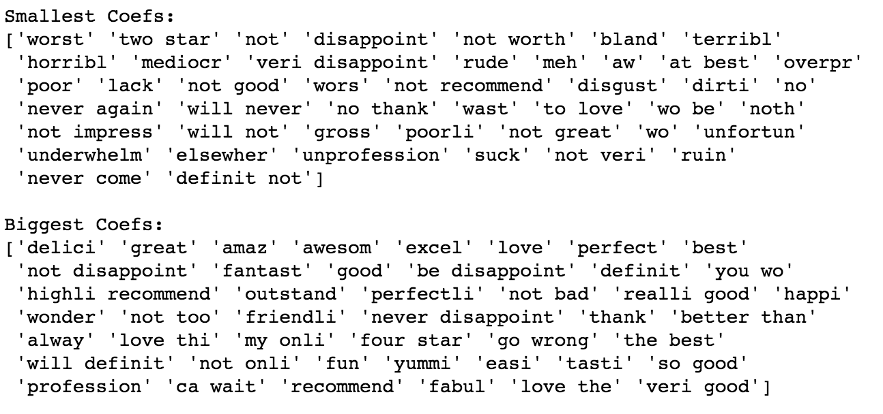
More Advanced Classifier...

Slide 25
More Advanced Classifier...
Let’s Try it out!

Slide 26
Future Directions
Manually go over misclassified reviews
Cross-validate the model to improve accuracy
Predict the actual review_stars
Try even more advanced models like LSTM

Slide 27
LSTM(Long-Short Term Memory network)
RNN recurrent neural networks
Capable of understanding context
Example: I used to like this place when I was young, but not anymore.
Notes:
Requiring fast machines, huge amount of data

Slide 28
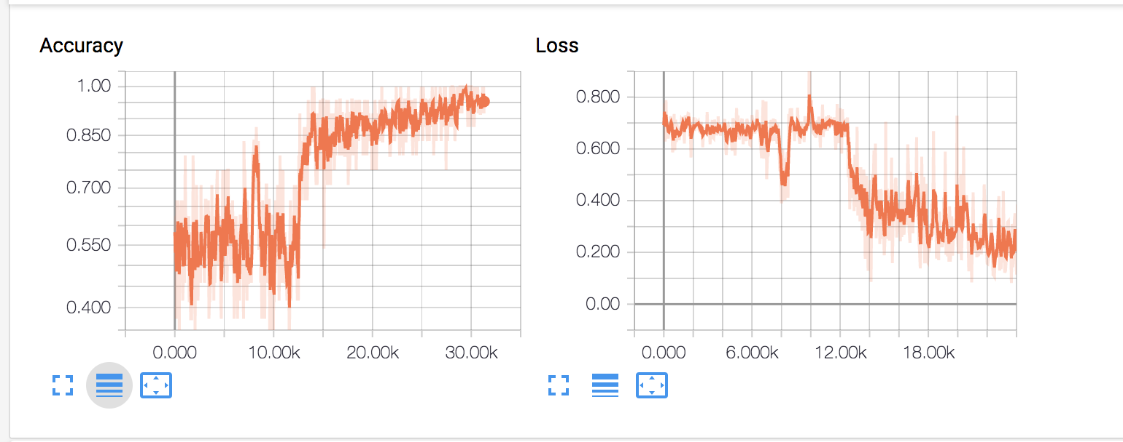
Future Directions

Slide 29
Thank you for listening!

